Slide 1

HAC ONLINE ROOM ALLOCATION SYSTEM

Slide 2
TEAM NAME: tech bots DONE BY: ABINAYA L ANJALI NIRANJANA CHUJEETHA R JAI SREE A
The main objective of our web application is to be a hostel and canteen guide for all students to have a e

Slide 3




HAC ONLINE ALLOCATION SYSTEM
PROBLEM STATEMENT
DESCRIPTION OF SOLUTION
WHY THIS PROJECT?
IMPLEMENTATION OF PROJECT

Slide 4
PROBLEM STATEMENT
.
As we all know this pandemic has affected everyone in some or the other way
Especially students are facing difficulties which causes problems in their day to day
Student who willing to stay in hostels cannot come directly to book their hostel rooms and enquire about required details

Slide 5

DESCRIPTION OF SOLUTION
The main objective of our web application is to be a hostel and canteen guide for all students to have a easier life in college. The process allows self allocation of hostel room and view everyday's breakfast and lunch menu which is useful and efficient.

Slide 6
WHY THIS PROJECT?
Stores and retrieves records of students/staff.
Reduces time and man power.
Flexible to maintain and update the records.
Validation is standard and impassive.
Loss and damage of records can be prevented.
Interactive and convenient GUI.
1

Slide 7



Tech stack
Frontend: HTML,CSS and Javascript
Backend: Wamp (Apache Server, MySQL, phpMyAdmin) PHP

Slide 8
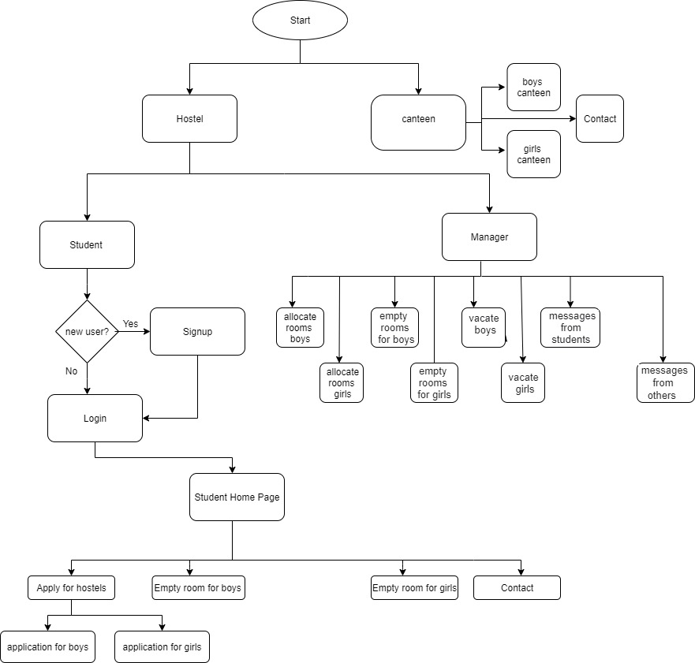
Flow chart

Slide 9

IMplementation

Slide 10
Thank you

